Slide 1
Book Recommendation System

Slide 2
Presented By
Mr. Saurabh Sunil Diwane
Mr. Akash Shankar Linganwar
Mr. Hari Krishna Guvvala
Miss. Daggumilli Priya Madhuri
Mr. Sachin Botla
D. Lily Susanna

Slide 3
Index
Objective
Data Summary
EDA and Visualizations
Model Building and Model Evaluation
Model Deployment

Slide 4
Objectives
From the given dataset we are about to build the popularity based, and collaborative filtering based model using the cosine similarity ,CSR matrix algorithms so as to get top n number of recommendations.
Improve user engagement and satisfaction by providing relevant book recommendations that match their interests and needs.
Increase book sales by suggesting relevant books to users who are more likely to purchase them.
Develop a user-friendly interface that is easy to use and navigate, making it simple for users to discover and select books they would like to read.

Slide 5
Data Summary
From the dataset, we have
Books.csv
Columns = ('ISBN', 'Title', 'Author', 'Year', 'Publisher', 'Image-URL-S’, Image-URL-M', 'Image-URL-L’)
Shape =(271360, 8)
Rating.csv
Columns = ( 'User_ID ’ , 'ISBN', 'rating’ )
Shape =(1048575,3)
Users.csv
Columns = ('User_ID', 'Location', 'Age’ )
Shape = (278858,3)

Slide 6
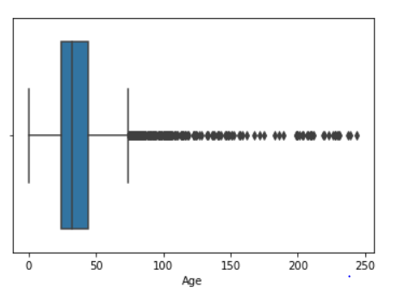
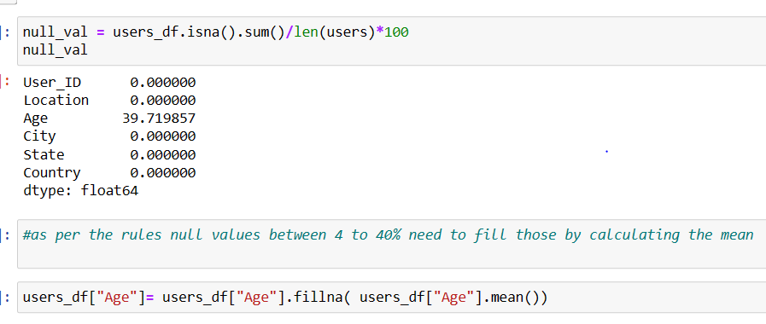
EDA and Visualizations
From all the dataset we have dealt with all the null values and perform all the necessary correction as required
In the Age column which contain 39% null values which we have imputed with mean values

Slide 7
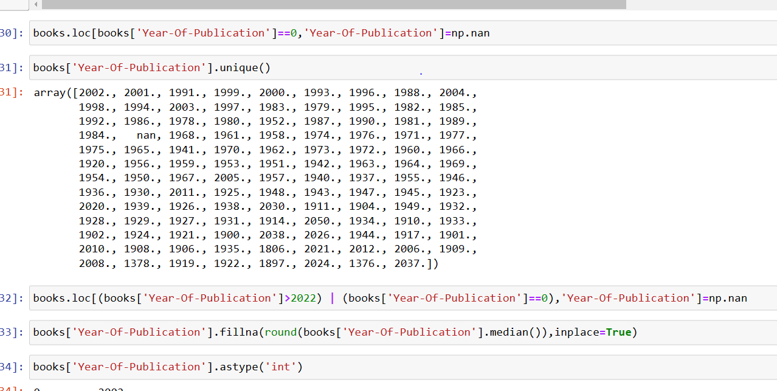
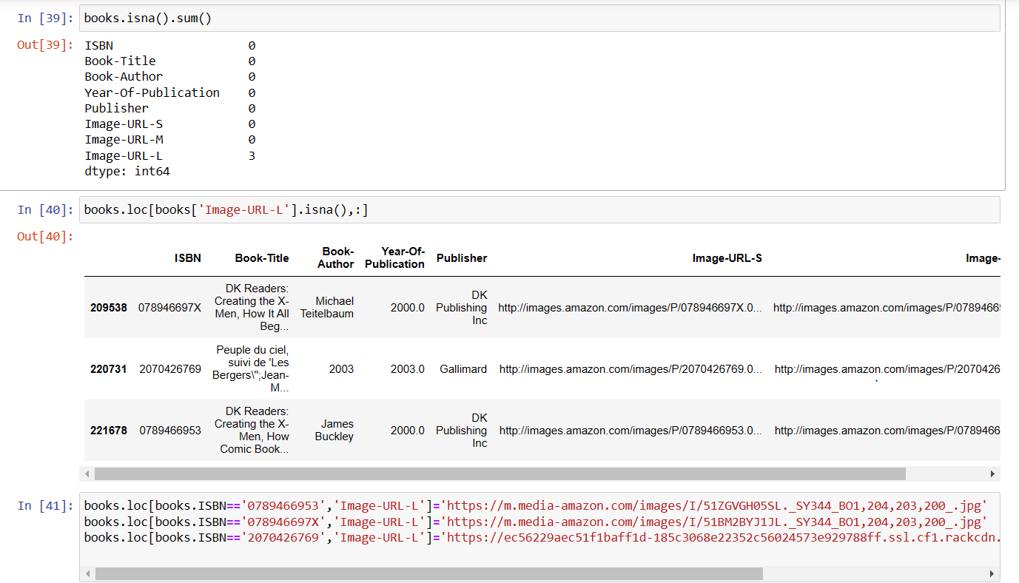
Also below are necessary correction performed in the dataset
Here we have updated year of publications, Image-URL’s and the data types of all the columns

Slide 8
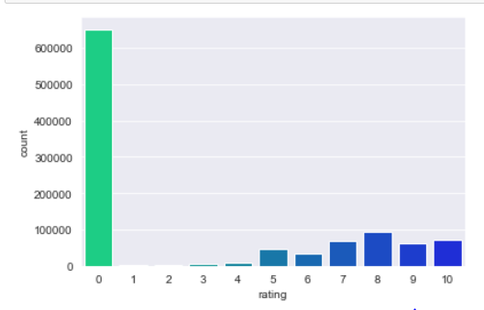
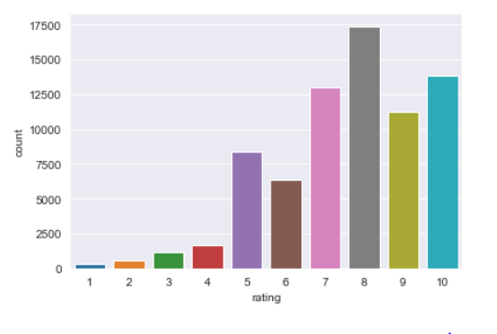
After merging all the dataset we have divided the data in rating explicit
And rating implicit.
Below are some visualization of ratings with user who gave 0 ratings(data implicit)
and users who gave more than 0 rating(data explicit).

Slide 9
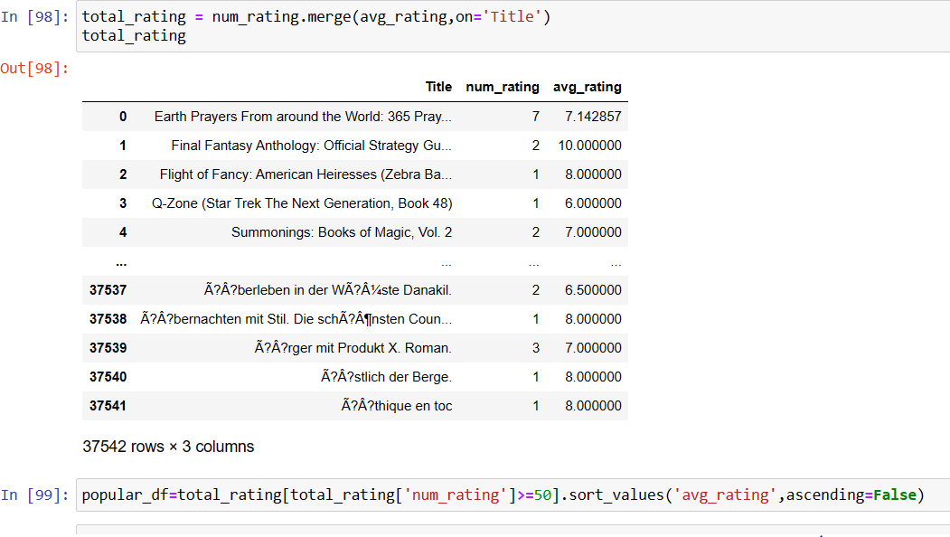
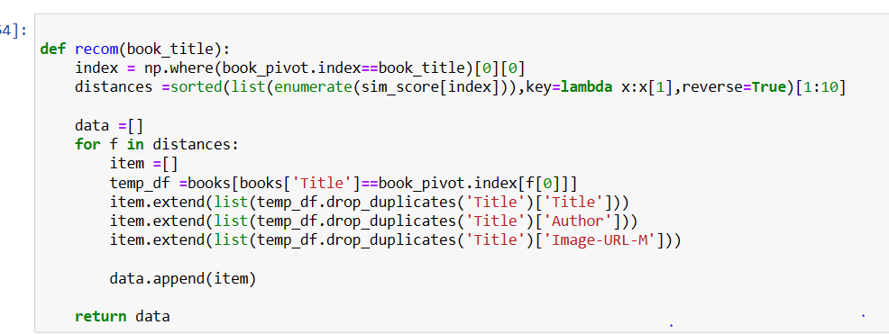
Model Building and Model Evaluation
Popularity based Model
In this model we have filtered top 50 books as per the num_rating more than 50
and avg_rating from descending sequence
Collaborative filtering based model
We have build the model using cosine similarity, we have created the pivot table to
Calculate the distance between the similar users.

Slide 10
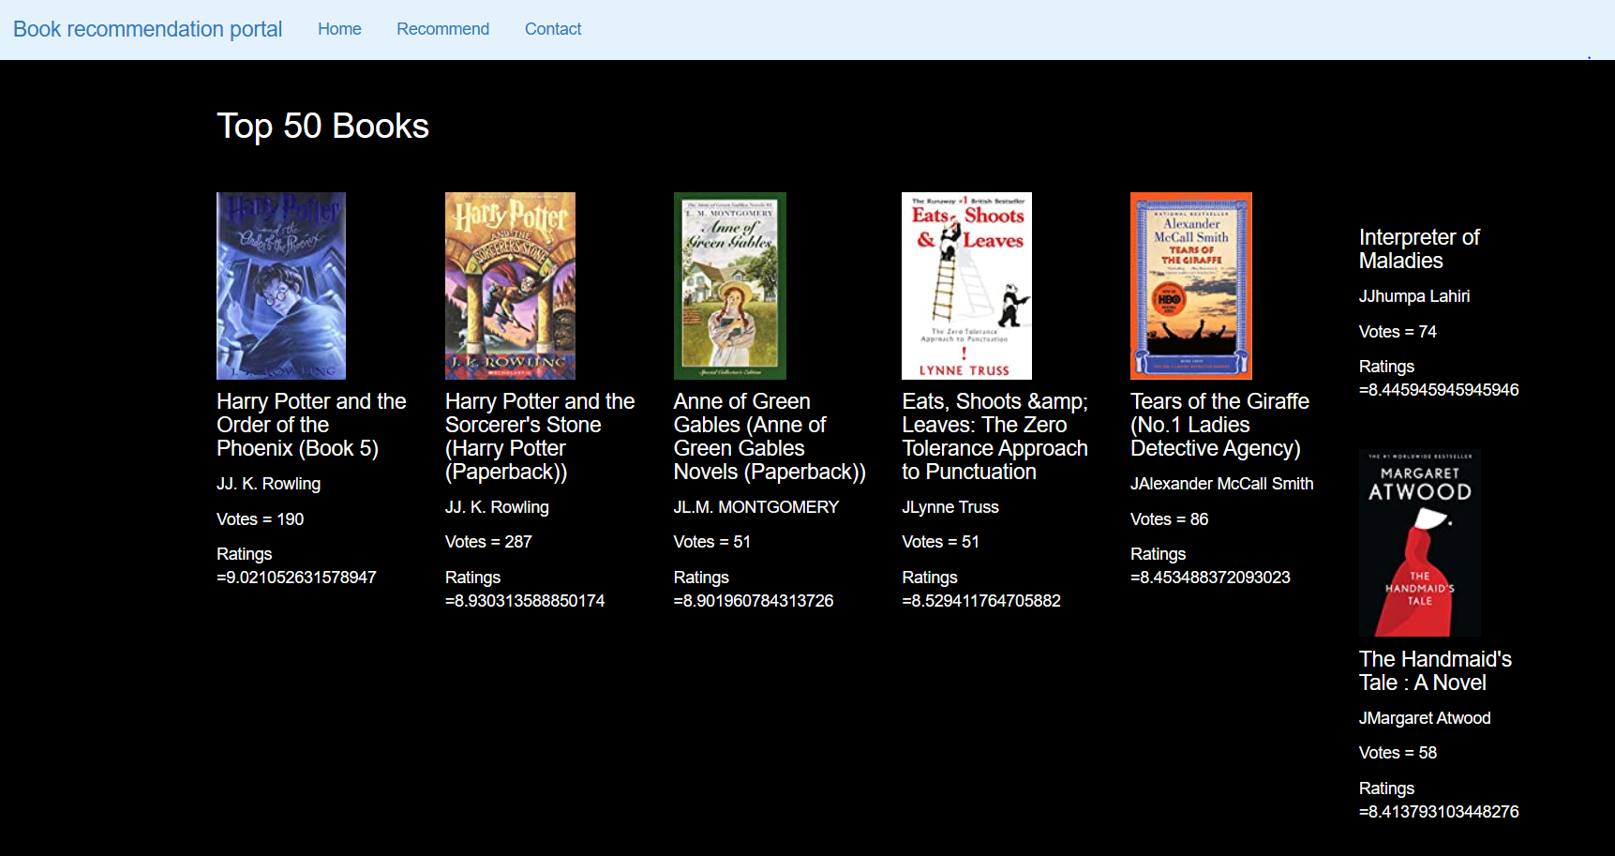
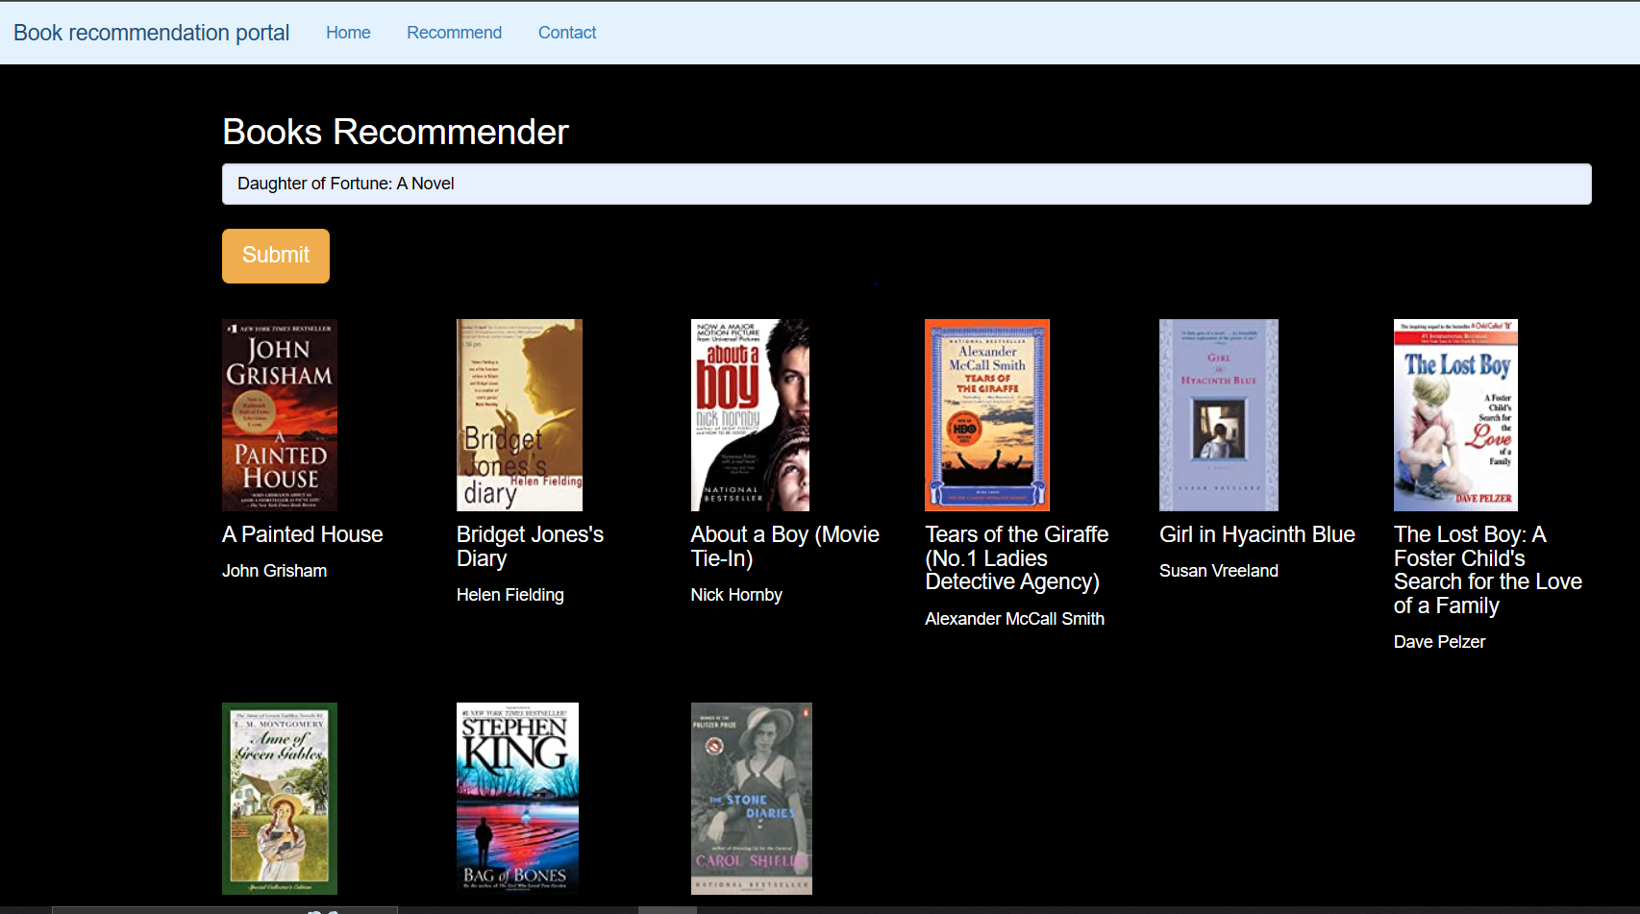
Model Deployment
The first snip refers to the Top 50 books as per the popularity based
recommendations.
2nd snip refers to the top recommended books as per the search result

Slide 11
Conclusion
In conclusion, a book recommendation system model can be a powerful tool for providing personalized book recommendations to users based on their preferences and reading history.
A popularity-based model is more appropriate for a simple and straightforward recommendation system, while a collaborative filtering-based model is more suitable for a more advanced system that prioritizes personalization , accuracy and individual user preferences
The model we have implemented gives Top 50 popular books and top similar books data as per the search result which enhance the users engagement and experience , which further increase the users satisfactions.

Slide 12
Challenges Faced
As per the data we first received our main objective was to rearrange
the data , Correcting the column details was bit tricky as data was
referring to insignificant meanings.
Null value imputations, and functions implementation was challenging part
During the process.
Selecting algorithm was also a challenging part, as for each algorithm has it’s pros
and Cons.
Providing personalized recommendations to each user is essential to the success
of the recommendation system. However, it can be challenging to capture
the individual preferences and pattern for giving similar recommendations.

Slide 13
Thank You

